Slide 1
MEKON/HOBO Introductory Tutorial
[Under Construction]

Slide 2
Tutorial Generalities
Based on:
HOBO/MEKON demo model
MEKON Model Explorer
Provides:
Introduction to MEKON Model Explorer
Overview of MEKON + HOBO models
+ Associated functionality
Specific model-instantiation examples
+ Explanations of functionalities invoked

Slide 3
Tutorial Pre-Conditions
Basic familiarity with:
Frames-based knowledge representation
OWL + Description Logics
Accessed MEKON project website (*)
Viewed general introductory material
Checked-out all code and resources
Built all code and resources
Preferably using ANT build script provided
* https://code.google.com/p/mekon

Slide 4
Tutorial Content
Using MEKON Model Explorer to:
Browse of model:
Basic MEKON version of model
Hybrid HOBO/MEKON version of model
Manipulate model-instantiations:
Creating + storing “assertion” instantiations
Creating + executing “query” instantiations

Slide 5
Tutorial Format
Actions:
The tutorial describes a series of actions to be performed via the MEKON Model Explorer (ME)
The action descriptions come with screenshots showing either the actions being performed, or the results of the actions having occurred
Explanations:
Explanations are provide concerning the functionalities being displayed as the actions are performed
Interspersed throughout the tutorial are “general explanations”, not specifically linked to the actions on particular slides, but more generally applicable to various actions on previous and/or subsequent slides
Icons:
The semantics of the ME icons are summarised at the start of the tutorial (a similar glossary can also be obtained via the ME “Help” button)
Recaps are provided throughout for specific icons as they are introduced
The semantics of specific icon modifiers are also provided at the relevant points

Slide 6
1. Browsing Basic MEKON Version of Model

Slide 7
General Explanation:
MEKON provides representational entities operating at three distinct levels: concept-level, instance-level and meta-level.
Concept-Level : Representation of domain model
C-Frame: Domain concept
C-Number: Numeric-value definition (numeric-type + valid value-range)
C-Value: Concept-level value-entity (C-Frame or C-Number)
C-Slot: Inter-concept relationships OR numerical attribute of concept
Instance-Level: Representation of specific instantiations of domain model
I-Frame: Instantiation of domain concept
I-Number: Specific numeric value
I-Value: Instance-level value-entity (I-Frame or I-Number)
I-Slot: Inter-instance relationships OR numerical attribute value
Meta-Level: Representation of references to domain model
M-Frame: Reference to domain concept (used solely for defining value-types of C-Frame-valued slots)

Slide 8
Icon Summary:
Shapes (all relevant colours)
Entity Category
Entity Level
Icon Shape
Value Entity (*)
Meta
Value Entity (*)
Concept
Value Entity (*)
Instance
Slot
Concept / Instance
* Frame OR Number
Colours (all relevant shapes)
Entity Category
Entity Source
Icon Colour(s)
Frame/Slot
Internal (*)
Frame/Slot
External (**)
Frame/Slot
Internal AND External
Number
ANY
* Derived from Object Model
** In the case of demo model, derived from OWL ontology

Slide 9
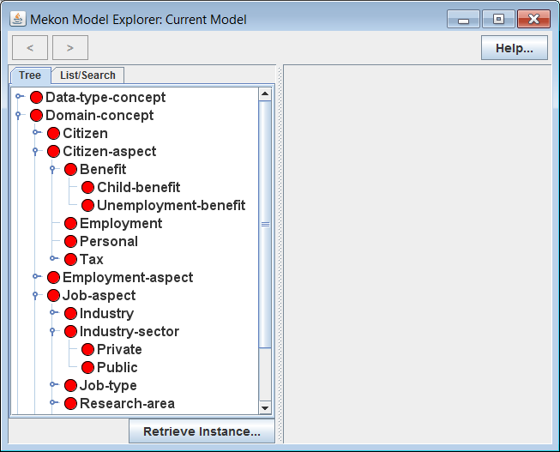
Actions:
Invoke ME with basic MEKON frames model (FM) version of demo model
Open-up and explore tree in LH panel
Explanation:
Tree represents hierarchy of all concept-level frames, or C-Frames, in model.
Model consists of this set of CFrames, together with associated sets of concept-level slots , or C-Slots (not currently visible)
Icons Recap:
C-Frame / derived from ontology

Slide 10
General Explanation:
Model Building: Basic MEKON frames models are derived entirely from one or more external sources, typically of an ontology like nature. This contrasts to hybrid HOBO/ MEKON models in which part of the frames model is derived from a HOBO-based object model.
MEKON-OWL Model Builder Plug-in: In the case of the demo model, the basic version of the model is built from an OWL ontology by the standard plug-in. This plug-in uses some fairly obvious mappings, such as:
OWL class → C-Frame
Existential property restriction → C-Slot
Etc.
MEKON Configuration File: This file directs the entire model building process, specifying the relevant model-building plug-in(s), and any required reasoning plug-ins to be attached (such as the MEKON-OWL reasoning plug-in), and providing the required configuration information for each.
The same file is also used to specify the object model for HOBO/MEKON models, and any bindings between it and the externally derived sections of the model.

Slide 11
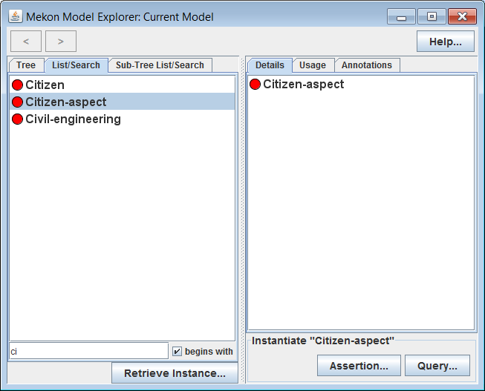
Actions:
Select various C-Frames in LH panel, including some with sub-frames
Select “List Search” tab in LH panel
Filter resulting C-Frames list by typing into text-box
Select specific C-Frames from resulting lists
Explanation:
Details of selected C-Frames appear in RH panel (to be explained in subsequent slides)
“Sub-Tree List Search” tab appears when any C-Frame with descendants is selected, containing list consisting only of descendants of selected C-Frame

Slide 12
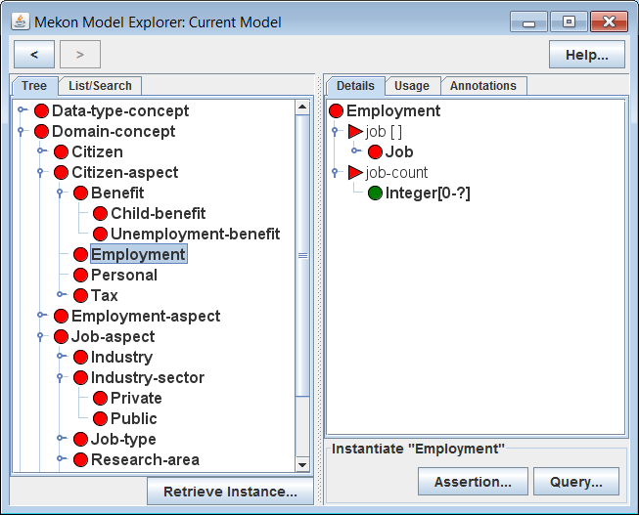
Actions:
Select Employment C-Frame in LH panel (via any of the three tabs)
Explanation:
Details of Employment C-Frame appear in RH panel, including details of two attached slots:
job: I-Frame-valued slot (values must be instantiations of the Job C-Frame)
job-count: Integer-valued slot (value-type is a C-Number, specifying valid I-Number values)
Icons Recap:
C-Slot / derived from ontology
C-Number / any source
(same source as parent-slot)

Slide 13
General Explanation:
Slot Value-Types: Each C-Slot provides a value-type, which defines the valid values for the instantiating I-Slots. Value-types are represented via entities from the level above that of the values that the I-Slot will have:
Possible slot value-types are:
M-Frame: Defines C-Frame-valued I-Slot
C-Frame: Defines I-Frame-valued I-Slot
C-Number: Defines I-Number-valued I-Slot
Fixed Values: A C-Frame can provide sets of “fixed-values” for instantiations of specific C-Slots on either the C-Frame itself or on any of it’s ancestors.
When the relevant C-Slots are instantiated, along with the C-Frame, any such values will be automatically added to the instantiating I-Slots.
Note: Fixed-values can only be defined for C-Frame-valued and I-Number-valued slots. They are not applicable to I-Frame-valued slots.
(See later slides in this section for examples of fixed-values.)

Slide 14
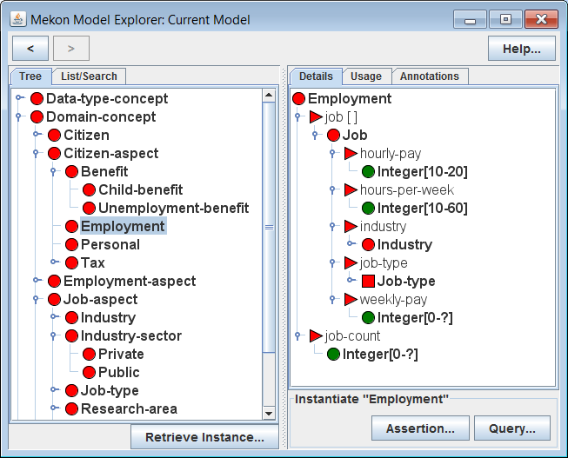
Actions:
Recursively expand section of tree under Job C-Frame representing value-type of job slot in RH panel
Explanation:
Details of Job, along with all other C-Frames representing slot value-types, are recursively displayed in RH panel
Displayed details include details of both slots and descendant C-Frames
Value-type of jobType slot is a meta-level frame, or M-Frame, rather than a C-Frame. Hence the values for that slot will be C-Frames rather than I-Frames
Icons Recap:
M-Frame / derived from ontology

Slide 15
General Explanation:
Model Instantiations: A specific model-instantiation is represented via an appropriate I-Frame/ I-Slot network, with the I-Frames and I-Slots being instantiations of the relevant C-Frames and C-Slots.
Instantiation Initialisation: When a C-Frame is instantiated as an I-Frame, the I-Frame is initialised as follows:
All C-Slots on the C-Frame, and on any ancestor C-Frames, are instantiated as I-Slots, and attached to the I-Frame. Where there is more than one such C-Slot for a particular property, then a single I-Slot is created whose value-type is the intersection of the value-types of all contributing C-Slots.
All fixed-values on the C-Frame, and on any ancestor C-Frames, are added to the I-Slots.

Slide 16
Actions:
Navigate backwards and forwards through previous selections using “<“ and “>” arrows in top left of GUI
Select any C-Frame in the RH panel to update selection in LH panel (and hence to update displayed details in RH panel)

Slide 17
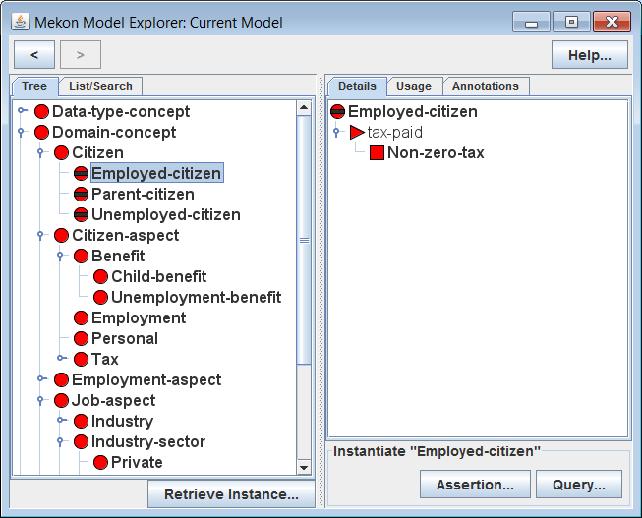
Actions:
Select Employed-Citizen C-Frame in LH panel
Explanation:
Employed-Citizen is a “hidden” C-Frame, which means that it cannot be instantiated, though it can play a role in the automatic updating of instantiations
If an I-Frame instantiating Citizen is inferred to be an instance of Employed-Citizen (*) , then the value-type of the tax-paid slot on that I-Frame will be automatically updated, from the default value, Tax, as provided by Citizen, to the more specific Non-zero-tax, as provided by Employed-Citizen
* See next slide for further explanation of I-Frame updating via OWL-based reasoning
Icon Modifier:
C-Frame is hidden

Slide 18
General Explanation:
Instantiation Updating: As the state of an instantiation (i.e. an I-Frame/ I-Slot network) is updated, additional updates may be automatically provided by appropriate reasoning plug-ins. In the case of the demo-model, this means the MEKON-OWL reasoning plug-in.
MEKON-OWL Reasoning Plug-in: Performs automatic instantiation updating as follows:
An OWL version of the I-Frame/I-Slot network is created: a class-expression if the network is a tree, a collection of individuals otherwise
The DL reasoner is invoked to find all inferred super-classes or inferred types of this OWL version
The corresponding C-Frames are found, and the associated C-Slots and fixed-values used to dynamically update the I-Slots on the root I-Frame of the instantiation

Slide 19
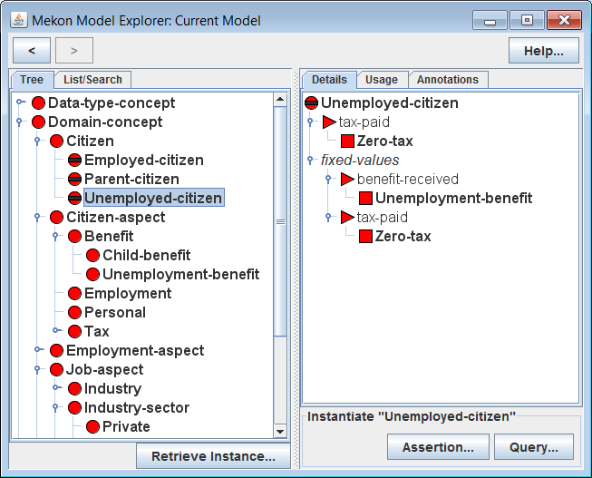
Actions:
Select Unemployed-Citizen C-Frame in LH panel
Explanation:
Unemployed-Citizen, similarly to Employed-Citizen, provides a specialisation of the value-type for the tax-paid slot
It also provides “fixed-values” for both that slot and the benefit-received slot, representing actual values that will be assigned to the relevant I-Slots whenever an I-Frame is classified accordingly.
Hence if an I-Frame instantiating Citizen is classified as an instance of Unemployed-Citizen, then not only will the tax-paid I-Slot be given a specialised value-type of Zero-tax, it will also be assigned an actual value of Zero-tax. Similarly the benefit-received I-Slot will be assigned a value of Unemployment-Benefit

Slide 20
2. Browsing Hybrid HOBO/MEKON Version of Model

Slide 21
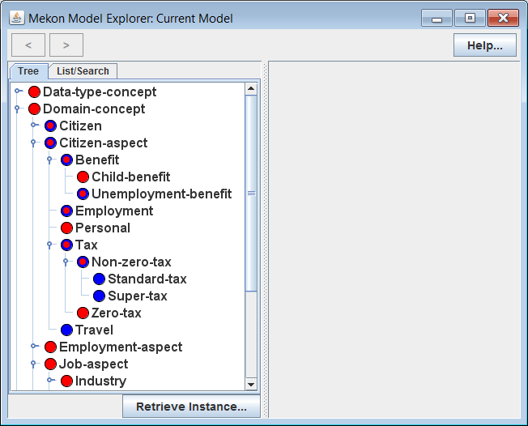
Actions:
Invoke ME with hybrid HOBO/MEKON, object model (OM) /frames model (FM) version of demo model
Open-up and explore tree in LH panel
Icons Recap:
C-Frame / derived from OM only
C-Frame / derived from both OM and ontology

Slide 22
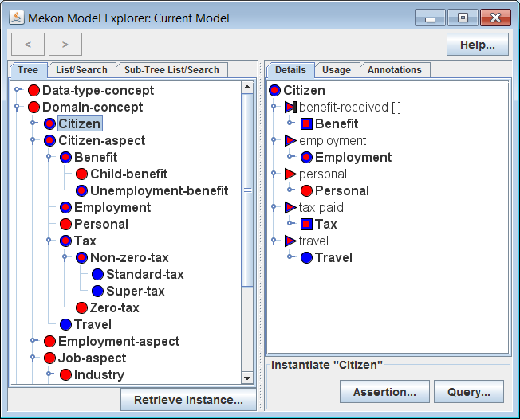
Icons Recap:
M-Frame / derived from both OM and ontology
Icon Modifier:
C-Slot / derived from both OM and ontology
C-Slot is a “derived” slot
C-Slot / derived from OM only (not shown)

